Slide 1


DATA MINING TECHNIQUES TO ESTIMATE OBESITY LEVELS
BY
HEMA LATHA. K
HAP 780 (data mining)
G01384405
Dr. Sanja Avramovic

Slide 2
Intorduction
Obesity is a medical condition that is characterized by excess body fat accumulation, which can lead to negative health consequences such as heart disease, diabetes, and certain types of cancer.
Obesity is typically measured using the body mass index (BMI), which is calculated as an individual's weight in kilograms divided by their height in meters squared.
According to the World Health Organization (WHO), individuals with a BMI of 25 or higher are considered overweight, and those with a BMI of 30 or higher are considered obese.
Obesity is currently a significant global issue, particularly in the United States, where approximately 41.9% of the adult population is obese.
According to the 19th Annual Report from Truth of America's Health, over 19 states in the US have an adult obesity rate of 35% or higher.
Various factors contribute to obesity, and these can vary from person to person. Some key factors include poor diet, inadequate sleep, sedentary lifestyles, and genetic predisposition to higher body weight.

Slide 3

AIM OF THE STUDY
The main aim of this study is to investigate the association between obesity levels and the presence of a family history of overweight and obesity. By analyzing the data, the study aims to identify whether individuals with a family history of overweight or obesity are more likely to have higher obesity levels themselves. The focus is on understanding the relationship between family history and obesity risk, providing insights into the potential influence of genetic factors on obesity susceptibility.

Slide 4
DATA SOURCE
The data set that I am using is from UCI Machine learning repositories.
This data is for the estimation of obesity levels in people from the countries of Mexico, Peru, and Colombia, with ages between 14 and 61 and diverse eating habits and physical conditions as mentioned, data were collected using a web platform with a survey where anonymous users answered each question, then the information was processed obtaining 17 attributes and 2111 records.
The attributes related to eating habits are Frequent consumption of high-caloric food (FAVC), Frequency of consumption of vegetables (FCVC), Number of main meals (NCP), Consumption of food between meals (CAEC), Consumption of water daily (CH20), and Consumption of alcohol (CALC).
The attributes related to the physical condition are Calories consumption monitoring (SCC), Physical activity frequency (FAF), Time using technology devices (TUE), and Transportation used (MTRANS), other variables obtained were Gender, Age, Height, and Weight.
Finally, all data were labeled and the class variable NObesity was created with the values of Insufficient Weight, Normal Weight, Overweight Level I, Overweight Level II, Obesity Type I, Obesity Type II, and Obesity Type III, based on Equation and information from WHO and Mexican Normativity.
The data contains numerical data and continuous data, so it can be used for analysis based on algorithms of classification, prediction, and association.

Slide 5
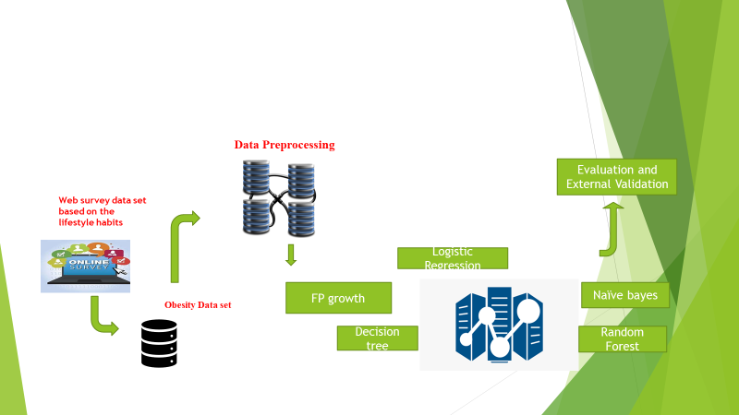
Methodology
Cleaning of the data by removing decimals, and nulls.
Then attribute coding of the data and calculated the BMI and their obesity levels were determined based on their BMI.
The data set was split into training and testing with 10-fold cross-validation after features were selected using the wrapper method in WEKA software.
The data was loaded into the Weka 3.8.6 software, and classification models were constructed to classify the data into underweight, normal weight, and obese categories.
I used the following steps to process the data.

Slide 6
Steps for Processing the Data
Data Preprocessing
Importing data into SQL Server and updating data types
Data cleaning: Removal of nulls and decimals
Binarization of data
Calculate BMI
Categorization of BMI
Joining the tables
Data featuring/ Splitting the data for data analysis.
Data analysis using WEKA
Logistic regression
Naïve bays
Random forest
Random tree

Slide 7
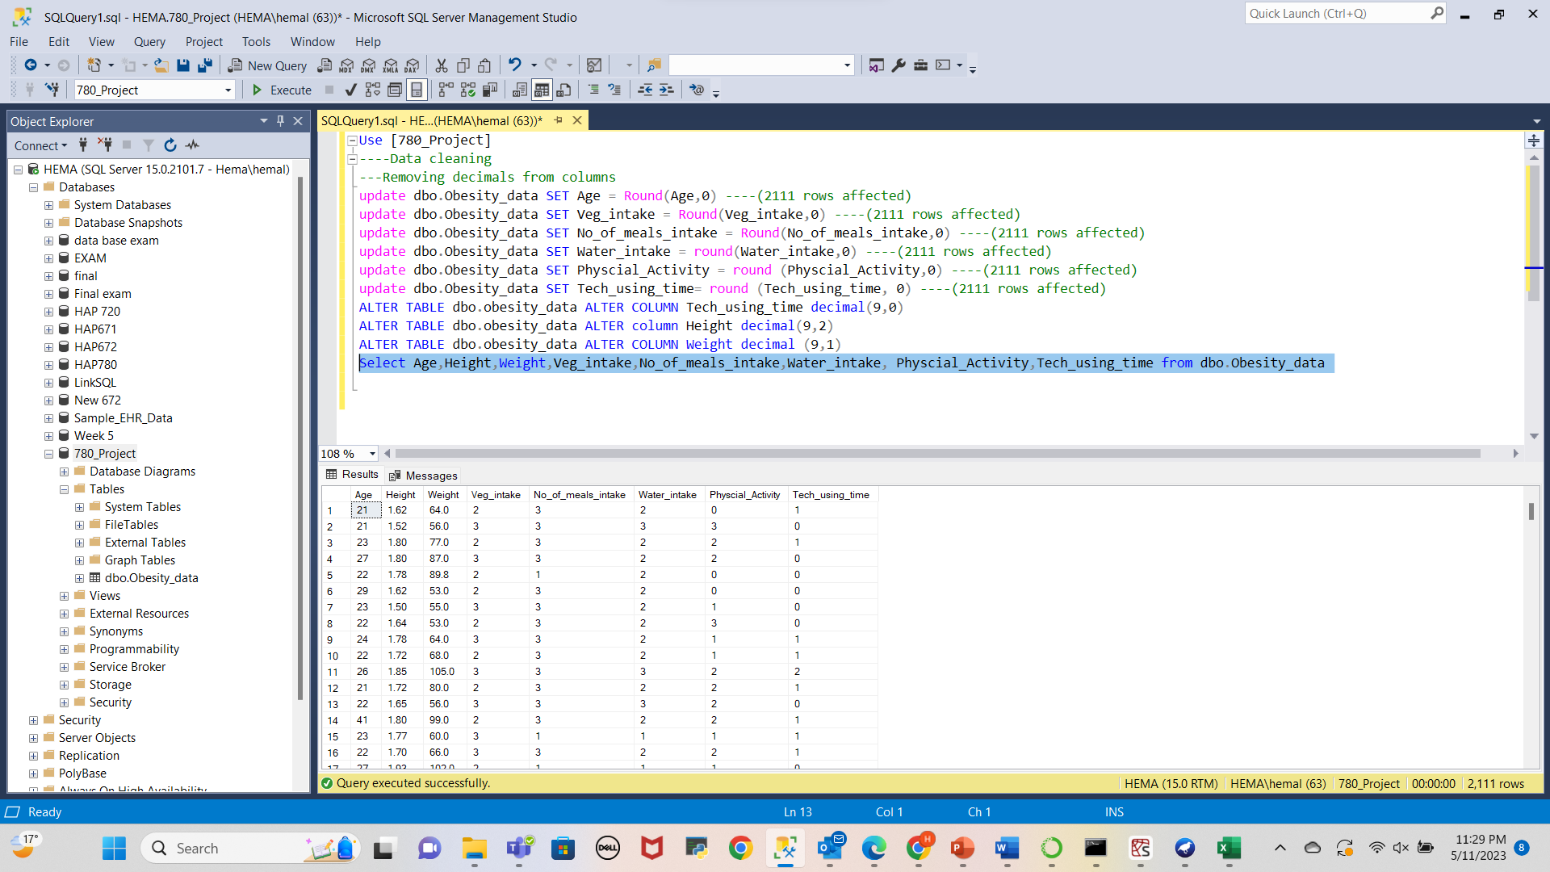
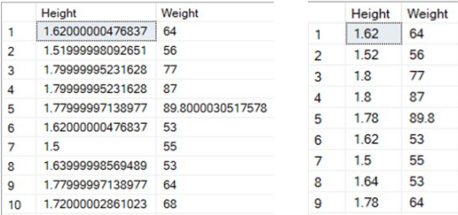
DATA CLEANING: REMOVING NULLS AND DECIMALS

Slide 8
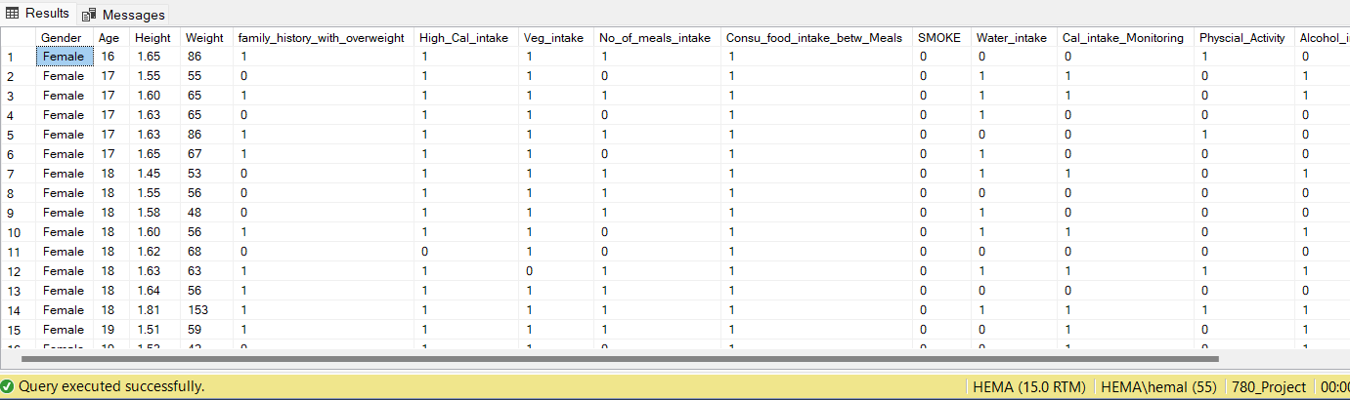
BINARIZATION OF THE DATA
To facilitate the modeling process in Weka and conduct frequent itemset mining for association analysis, we transformed the categorical attributes into a binary representation. This involved binarizing the attributes into '0' and '1' categories, based on specific criteria. By binarizing the categorical attributes in this manner, we were able to transform the dataset into a format suitable for conducting association mining using frequent itemset algorithms in Weka.

Slide 9
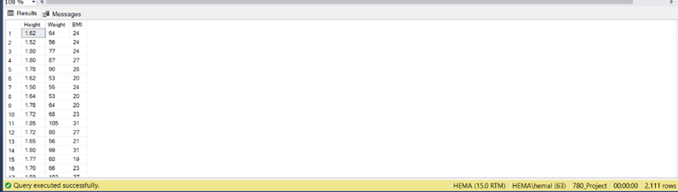
CALCULATING BMI
Body Mass Index (BMI) is a metric used to estimate an individual's body fat based on their weight and height. It is calculated by dividing the weight in kilograms by the square of the height in meters. Here's the formula:
BMI = weight (kg) / (height (m))^2

Slide 10
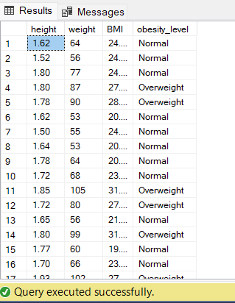
Categorization of BMI Attribute as underweight, normal, overweight
To categorize the BMI attribute into underweight, normal, and overweight ranges, standard BMI classification thresholds can be used. The following ranges are commonly employed:
Underweight: BMI less than 18.5
Normal weight: BMI between 18.5 and 24.9
Overweight/obese: BMI equal to or greater than 25
By comparing the calculated BMI value with these thresholds, the BMI attribute can be categorized accordingly. The classes are created and stored in a #BMI_table.

Slide 11
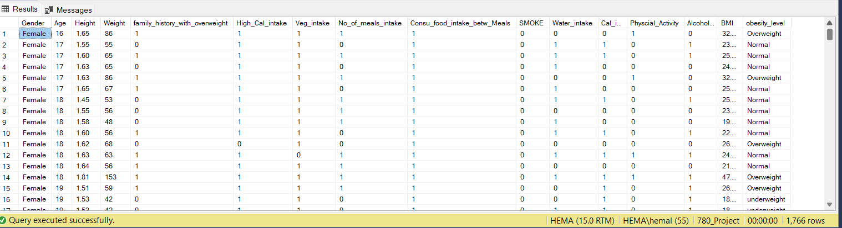
Join the tables :
The classes of obesity_levels were stored in a temporary table. So, Joined the temporary table with the obesity table based on a common key or identifier. This allowed us to combine the information from both tables into a single joined table. After the join operation, we obtained the final joined table, which included the attributes from the obesity table as well as the corresponding obesity_level classes.
Created the final data set.

Slide 12
Splitting the data for Data Analysis:
To conduct data analysis, the final dataset has 1766 records & they were split into training and testing sets using the 80/20 rule. The dataset was first randomly shuffled to ensure an unbiased distribution of instances. Subsequently, 80% of the shuffled data was assigned for training purposes, while the remaining 20% was reserved for evaluating the performance of the predictive models. This split enabled the construction of various predictive models using Weka's algorithms on the training data, allowing for learning and pattern discovery.

Slide 13
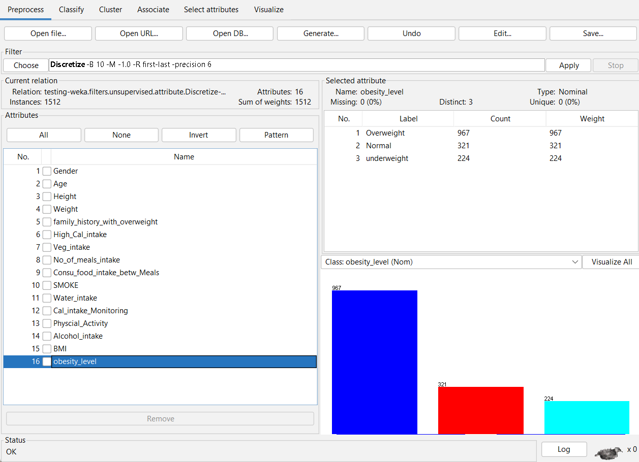
DATA ANALYSIS USING WEKA:
In the data analysis and model-building phase using Weka, the processed dataset was utilized.
The dataset was divided into training and testing data using the Percentage Split method, and 4 predictive models were built based on this approach.
The models were then evaluated using the testing data to assess their performance and predictive capabilities.

Slide 14
RESULTS:
This analysis reveals a correlation between family predisposition to obesity and the current state of obesity in adolescent and adult age groups.
In Table 1 presents the results of the Percentage Split Method, indicating the accuracy, precision, recall, and ROC area for each model on the training set.
Random Forest & Random tree achieves the highest accuracy of 100% and a ROC area of 1, demonstrating superior performance compared to other models.

Slide 15
RESULTS:
In Table 2 displays the results of the testing set evaluation.
Naïve Bayes achieves an accuracy of 88.67%, while Logistic Regression and Random Forest have accuracies of 87.19% and 89.2% respectively.
Random Tree performs the best on the testing set, achieving an accuracy of 91.6%.
These results highlight the models' performance on unseen data, with Random Tree outperforming the other models in terms of accuracy and ROC area.

Slide 16
Conclusion
This study helps to determine which model works better in determining obesity levels. Addressing obesity is crucial for reducing the prevalence of related comorbidities such as cardiovascular conditions and diabetes. By gaining insights into the factors contributing to obesity, we can work towards developing effective strategies and policies to combat this global health issue and improve overall public health outcomes.

Slide 17
LIMITATIONS
This study has several limitations that should be considered. Firstly, the training dataset used in this study consisted of a limited number of rows (2111), which may result in underfitting of the predictive models and affect their robustness. A larger dataset would provide more diverse and representative samples, allowing for better model training and generalizability.
Secondly, the level of awareness among the public regarding the risk factors and long-term consequences of obesity may vary. This could lead to a bias in the dataset, potentially resulting in an overrepresentation of individuals with higher obesity rates. Consequently, the findings may not fully reflect the broader population's obesity patterns.

Slide 18
RECOMMENDATIONS
In this study I observed a strong correlation between a family history of obesity and high-calorie food intake in the dataset. This suggests that family history is closely linked to the food habits of individuals, which in turn impact their lifestyle and obesity levels. The combination of family history and high-calorie intake emerged as a major contributing factor to obesity.
To further explore this relationship, future studies could incorporate the attribute of physical activity. By examining the impact of physical activity alongside family history and high-calorie intake, we can gain a deeper understanding of how lifestyle modifications, such as engaging in regular exercise, can potentially mitigate the influence of family history on obesity levels.

Slide 19

Thank You

